Slide 1
BALEAP TAFSIG AGM
2nd November 2022
13.00 – 13.20 UK time (followed by Coffee Club until 14.00)
Notes:
Welcome and apologies

Slide 2
Welcome: Housekeeping
Session runs 13:00 – 14:00 GMT (~20 min AGM, then Coffee club)
Use Chat function to comment or ask a question, or raise your hand
This meeting is being recorded and will be shared on the TAFSIG website and YouTube channel

Slide 3
TAFSIG is 3 years old!

Slide 4
Agenda
Meet the committee
Membership update + upcoming activities (Rob/Emma)
Review of 2021-22 SIG events (Sam)
Projects update (Eddie)
Finances (Wayne)
Goodbyes and hellos (Rob)
AOB
Coffee club

Slide 5
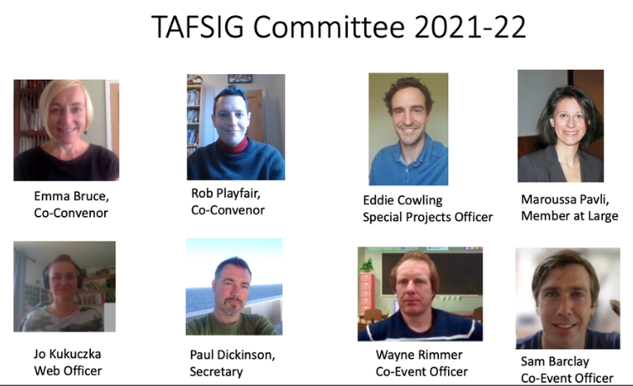

Slide 6
Membership
Committee grown from 5 to 8 members
120 members on the mailing list (76 last year)
41 UK universities (35 last year)
Also members from Ireland, Japan, USA, Brazil, Kazakhstan, China, Japan, Iran, Saudi Arabia, Malaysia, Australia, Taiwan, Turkey, Germany, Canada, Italy – but still majority UK.
4 testing organisations – BAAL, UKALTA, ARG, Trinity,

Slide 7
Assessing Listening event (with Listening SIG) – date tbc
Piloting network
Upcoming activities 2022-2023
Coffee clubs every other month
BALEAP Conference, University of Warwick – April 2023
Webinars – please get in touch!
Blogs -please get in touch!

Slide 8
Review of last year’s events

Slide 9
Projects update: TAFSIG Piloting Network
2021-22 activity
Future Piloting Network developments
Find out more and register! Google ’TAFSIG piloting network’ or head to our web page

Slide 10
Projects update: Stats and test analysis

Slide 11
Finances

Slide 12
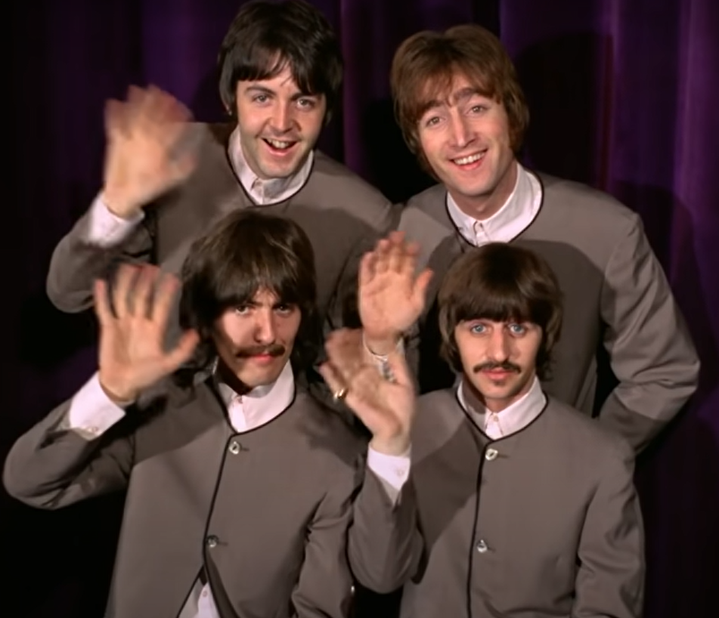
Goodbye and hello!
Thank you and goodbye to Jo Kukuczka (Web Officer) – we will miss you!
A warm TAFSIG welcome to:
Graham Shipman as Web Officer
Chris Smith as Ordinary Member

Slide 13
Questions, suggestions or comments?

Slide 14
BALEAP TAFSIG AGM
Thank you!
Visit our website: tafsig@baleap.org
Find us on Twitter: @taf_sig
Email us: tafsig@baleap.org
Get in touch to share your thoughts or experiences via a blog post or webinar!

Slide 15
Coffee Club

