Slide 1
BALEAP TAFSIG AGM
21st June 2023
12.00 – 12.20 UK time (followed by Coffee Club until 13.00)
Notes:
Welcome and apologies

Slide 2
Welcome: Housekeeping
Session runs 12:00 – 13:00 GMT (~20 min AGM, then Coffee club)
Use Chat function to comment or ask a question, or raise your hand
This meeting is being recorded and will be shared on the TAFSIG website and YouTube channel

Slide 3
TAFSIG is 4 years old!

Slide 4
Agenda
Meet the committee
Membership update (Rob)
Review of 2022-23 SIG events & conference
Projects update (Eddie)
Finances (Wayne)
Upcoming activities 2023 -2024
Goodbyes and hellos (Emma)
AOB
Coffee club

Slide 5
TAFSIG Committee
Outgoing:
Co-convenors: Rob Playfair and Emma Bruce
Events Officer: Sam Barclay
Treasurer: Wayne Rimmer
Existing:
Eddie Cowling - Special Projects Officer
Paul Dickinson - Secretary / Treasurer
Graham Shipman - Web Officer
Maroussa Pavli - Ordinary Member
Chris Smith - Ordinary Member

Slide 6
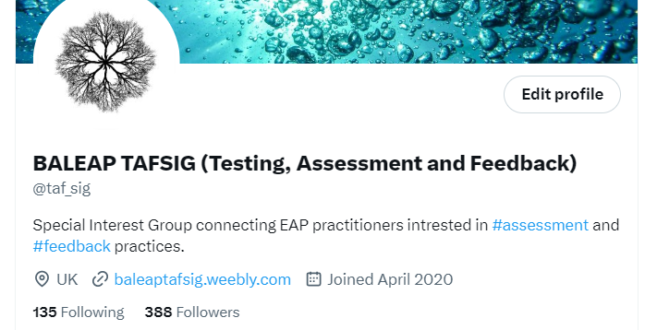
Membership
Committee is 9 members (4 outgoing)
133 members on the mailing list (120 last year)
Over 40 UK universities
Also members from Ireland, Japan, USA, Brazil, Kazakhstan, China, Japan, Iran, Saudi Arabia, Malaysia, Australia, Taiwan, Turkey, Germany, Canada, Italy – but still majority UK.
4 testing organisations – BAAL, UKALTA, ARG, Trinity,

Slide 7
Review of this year’s events & activity
Test Analysis Webinar ​(January) - recording and resources available on our website
Authentic Listening Assessment webinar (January)
Joint coffee club with TELSIG (March)
Participation in BALEAP 2023 Conference (April)
Bi-monthly coffee clubs
Website redesign

Slide 8
TAFSIG Piloting Network
2022-23 activity
Future Piloting Network developments
Find out more and register! Google ’TAFSIG piloting network’ or head to our web page

Slide 9
Finances

Slide 10
Coffee clubs every other month
Piloting network & related activity
Watch this space!
Upcoming activities 2023-2024
Webinars – please get in touch!
Test Analysis webinar and resources
Blogs or articles - please get in touch!

Slide 11
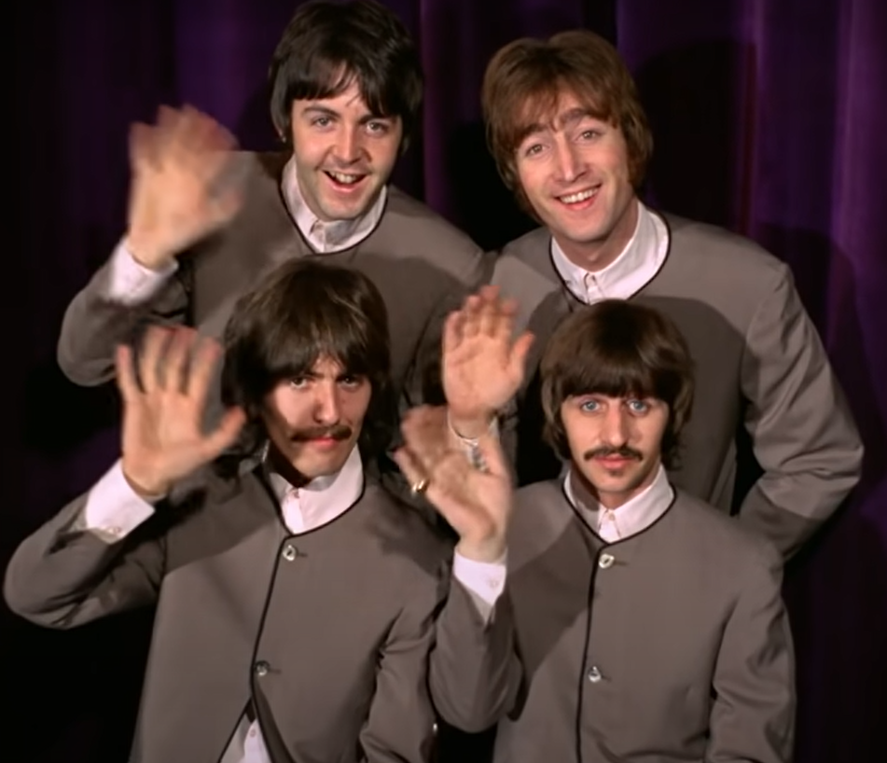
Goodbye and hello!
Thank you and goodbye to Rob, Emma, Wayne and Sam (all founding members) – we will miss you!
A warm TAFSIG welcome to members who joined since last year’s AGM:
Graham Shipman - Web Officer
Chris Smith - Ordinary Member
And to brand new members:
Phil Smyth - Convenor
Dina Strong - Events Officer

Slide 12
Questions, suggestions or comments?

Slide 13
BALEAP TAFSIG AGM
Thank you!
Visit our website: tafsig@baleap.org
Find us on Twitter: @taf_sig
Email us: tafsig@baleap.org
Get in touch to share your thoughts or experiences via a blog post or webinar!

Slide 14
Coffee Club

